Slide 1
Castrol Partner Program – LinkedIn & META statics images and copy

Slide 2
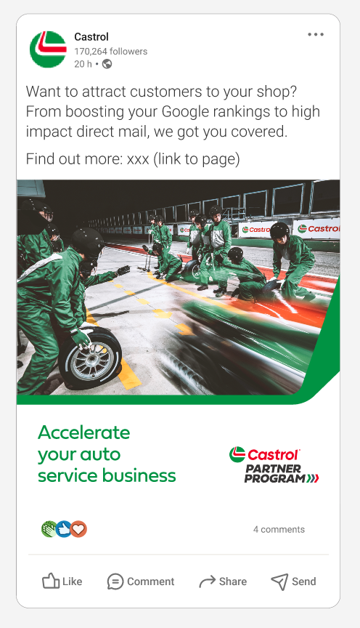
Castrol Partner Program content for LinkedIn/FB/Insta – Static 1
Copy Static 1:
Want to attract customers to your shop? From boosting your Google rankings to high impact direct mail, we got you covered.
Find out more: Castrol Partner Program | Castrol® USA

Slide 3
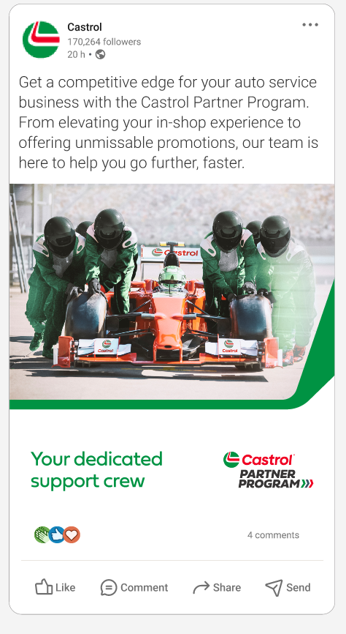
Castrol Partner Program content for LinkedIn/FB/Insta – Static 2
Copy Static 2:
Get a competitive edge for your auto service business with the Castrol Partner Program. From elevating your in-shop experience to offering unmissable promotions, our team is here to help you go further, faster. Castrol Partner Program | Castrol® USA

Slide 4
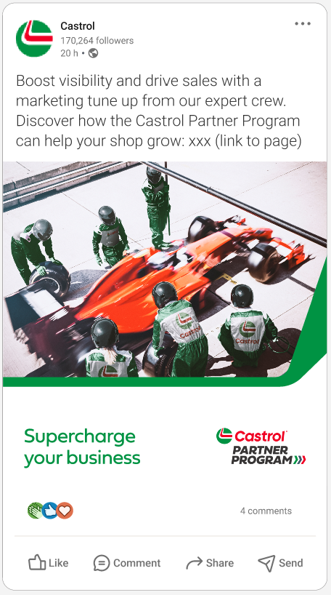
Castrol Partner Program content for LinkedIn/FB/Insta – Static 3
Copy Static 3:
Boost visibility and drive sales with a marketing tune up from our expert crew. Discover how the Castrol Partner Program can help your shop grow: Castrol Partner Program | Castrol® USA

Slide 5
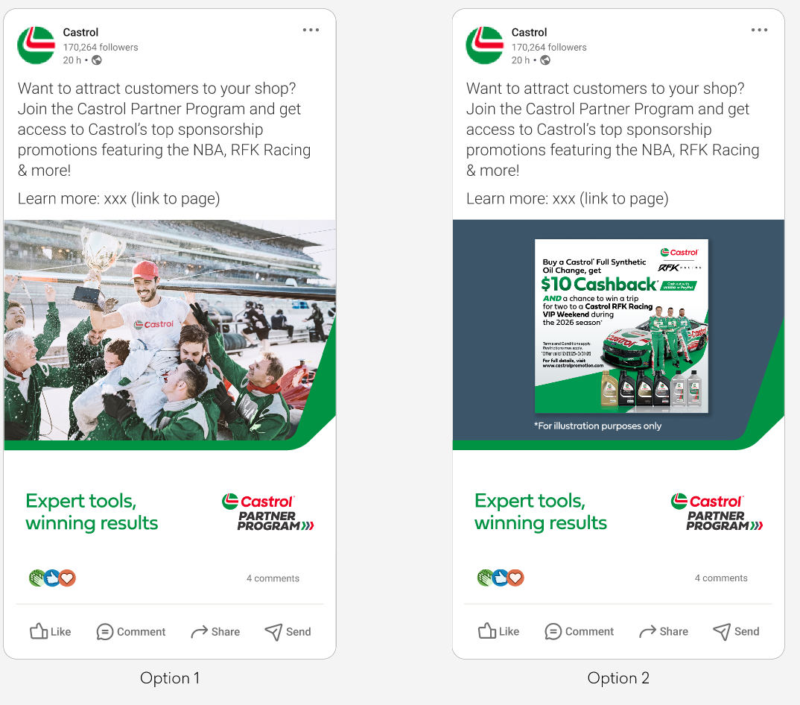
Castrol Partner Program content for LinkedIn/FB/Insta – Static 4a/b (alternative visuals)
Copy Static 4:
Want to attract customers to your shop? Join the Castrol Partner Program and get access to Castrol’s top sponsorship promotions featuring the NBA, RFK Racing & more!
Learn more:
Castrol Partner Program | Castrol® USA

Slide 6
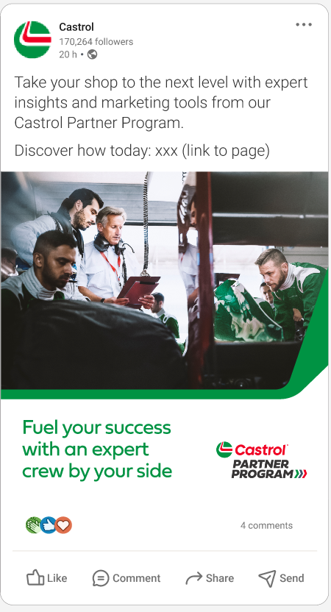
Castrol Partner Program content for LinkedIn/FB/Insta – Static 5
Take your shop to the next level with expert insights and marketing tools from our Castrol Partner Program.
Discover how today: Castrol Partner Program | Castrol® USA

